Slide 1
Global PBL with UBD Regular update meeting Flood Observing System Researching project
Advanced Institute of Industrial Technology
Hiroshi Adachi, Sayuri Yatabe,Hiroshi Kamatsuka
Yumiko Miyake(Assistant), Yosuke Tsuchiya(Professor)
Seiichi Kawata (President)
- In the previous project of Flood Observing System in 2015, we achieved to develop demonstrative product of simple function of flood Observing system from sensing data to storing and browsing in Web application.
- Thanks to great contribution of UBD, we were honored to get outstanding reputation, and we would like to keep this activity to improve our product for the level of practical use.

Slide 2
Agenda
2
Project communication plan
Introduction sheet
Introduction to Join Channel In Slack
Let’s Join Channel In Slack
Introduction to the GitHub Flow
UBD-AIIT-Global-Project_Phase1 Repositories
Progress update
Overall Schedule
Progress on Web development
WebService-DemoSite (2015 GlobalProject’s Deliverables)
Research plan
Next Action

Slide 3

Project communication plan
Project Lead
Execution
Project execution
Local support
Project Owner: Seiichi Kawata
Supervisor: Yosuke Tsuchiya
Assistant: Yumiko Miyake
Project Manager: Hiroshi Adachi
Technical Lead: Sayuri Yatabe
Developer: Hiroshi Kamatsuka
Project Owner: Prof Liyanage C De Silva
Project Leader: Dr Muhammad Saifullah Bin Abu Bakar
Project Technical Lead: Dr Pg Emeroylariffion Abas
Project Technical Lead: Dr Sandhya Aneja
Project member:
Project Technical Lead (Student): Malik Wise
Project Member:
Afieq Rosle
Ren Virrey
Next Action:
- Exchange Self-introduction sheet
- Define Communication path

Slide 4
Project communication Plan
4
We have selected Slack, GitHub's WikiPage, and Dropbox for our puroject's communication path toll.
These developer tools can be linked to each other
and it can facilitate development work.

Slide 5
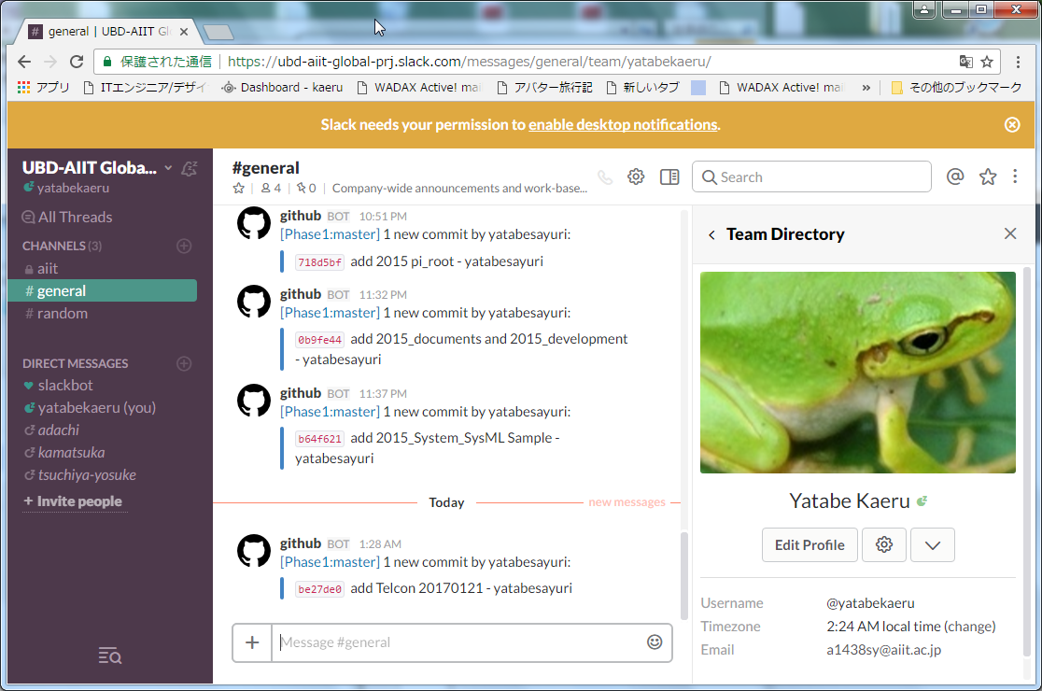
Introduction to Join Channel In Slack
5
https://ubd-aiit-global-prj.slack.com/messages/general/
Slack works in conjunction with GitHub！

Slide 6
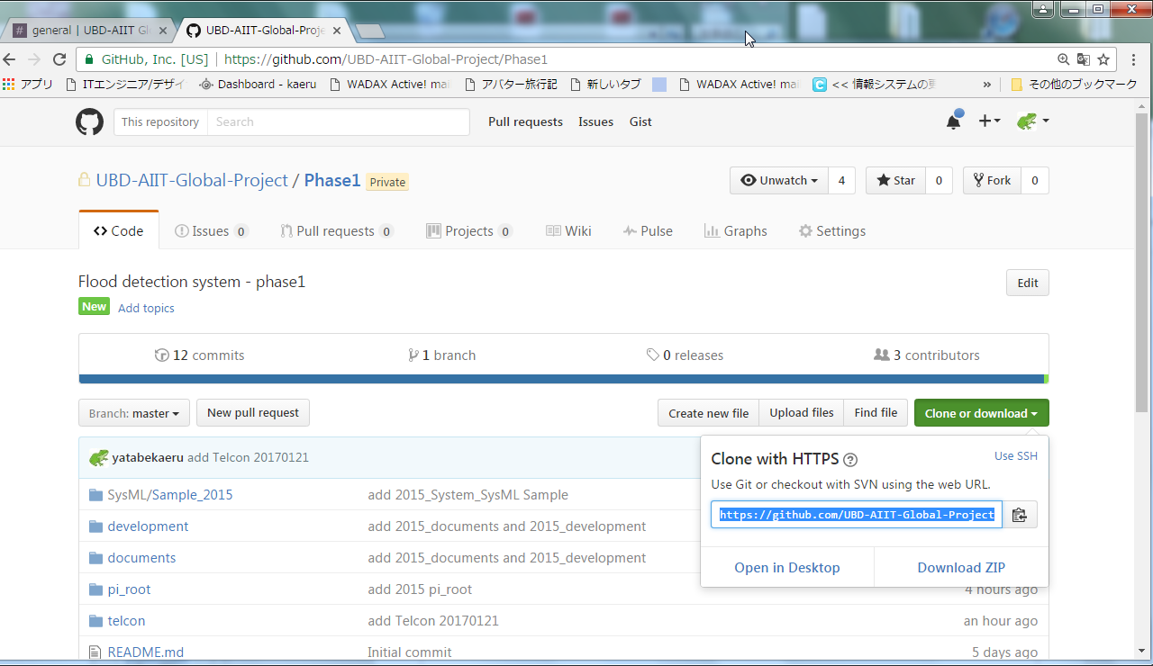
Introduction to the GitHub Flow-01
6
URL :
https://github.com/UBD-AIIT-Global-Project/Phase1
Clone :
https://github.com/UBD-AIIT-Global-Project/Phase1.git

Slide 7
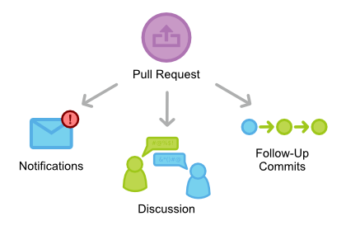
Introduction to the GitHub Flow-02
7
URL :
https://github.com/UBD-AIIT-Global-Project/Phase1
Clone :
https://github.com/UBD-AIIT-Global-Project/Phase1.git
Project management with github flow
(After Fixing our Server Side AP )

Slide 8
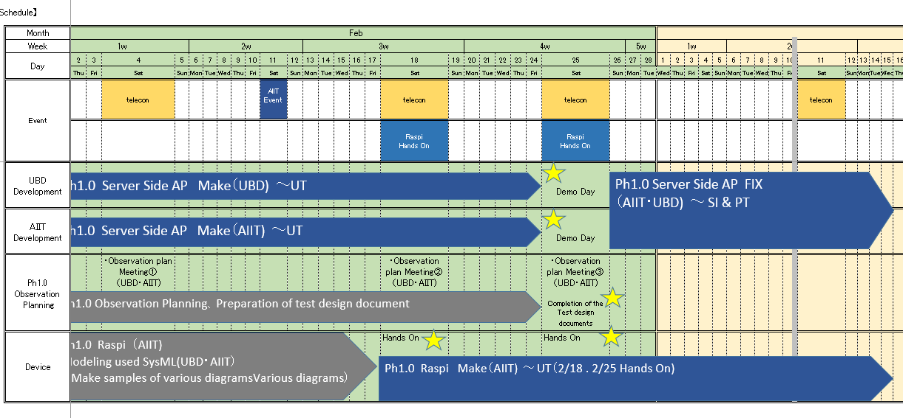
Progress Update-01
Phase1:Overall Schedule
Web application:
Sensing devices: provided to UBD
Observation plan
Sample modeling

Slide 9
Progress Update-01
Progress on Web development
Web application:
(AIIT):
Server Side AP Make ～Unit Test : 25th Feb.
Integration : 1st Mar – 18th Mar.
(UBD): to be defined, but expected Unit test to be completed before integration – 15th Feb.
WebService-DemoSite (2015 GlobalProject’s Deliverables)
please confirm GitHub Repository.

Slide 10
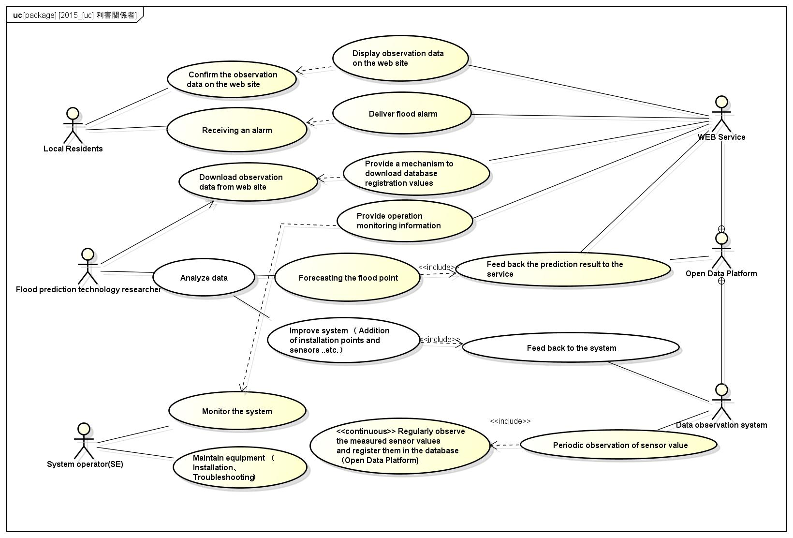
Progress Update-02 SysML for Phase 1（Update Status）
10
Discussion

Slide 11
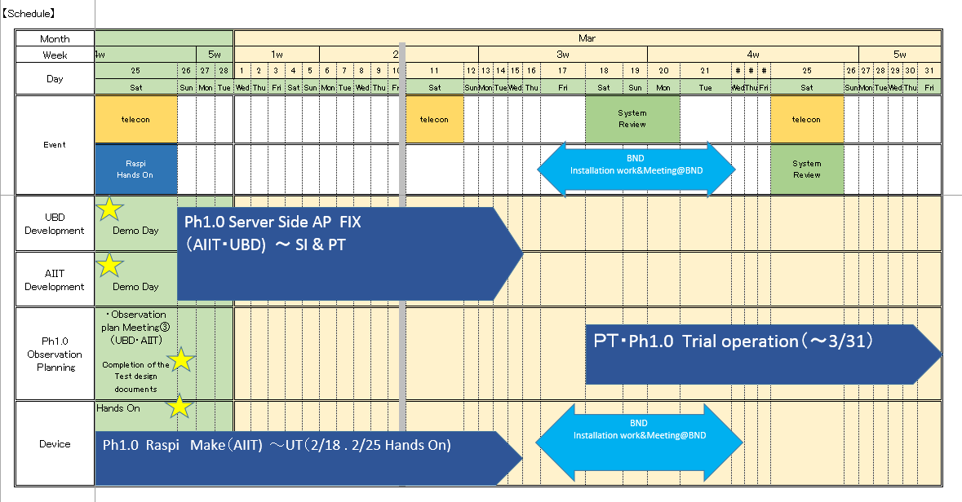
Observation plan
11
Observation plan

Slide 12
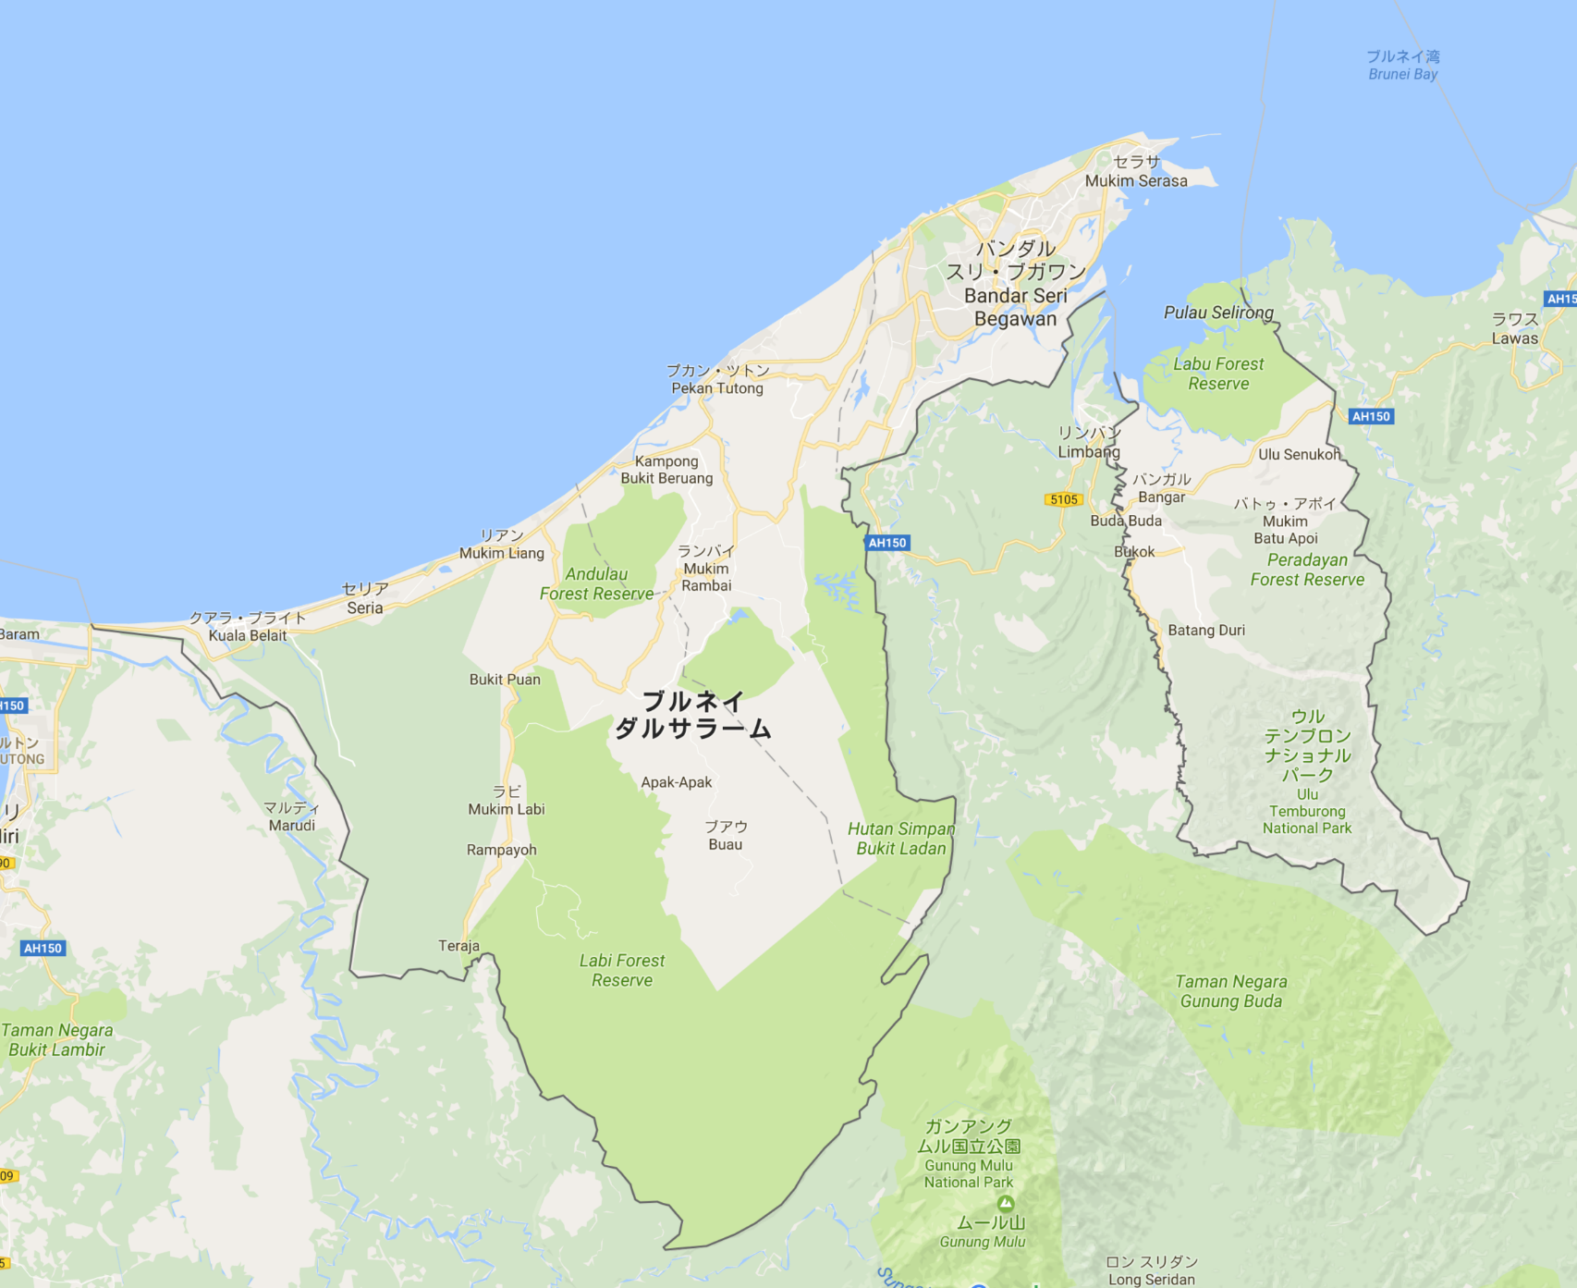
Next action
12
Observation system
installation location plan
UBD FIT
Somebody’s House
We need to install 5 systems
UBD pond
Necessary condition
- AC power supply
- Wi-Fi
Kampong Ayer
Temburong
KBFSC
KBFSC: Kuala Belalong Field Studies Centre

Slide 13
Next action
13
Progress on Web development（Review, Demo etc..)
Observation plan update
---- Next update call 2017/2/18 ---
.. And I hope to discuss more freely in your free time.
Slack chat
Github Wiki Page

